Slide 1
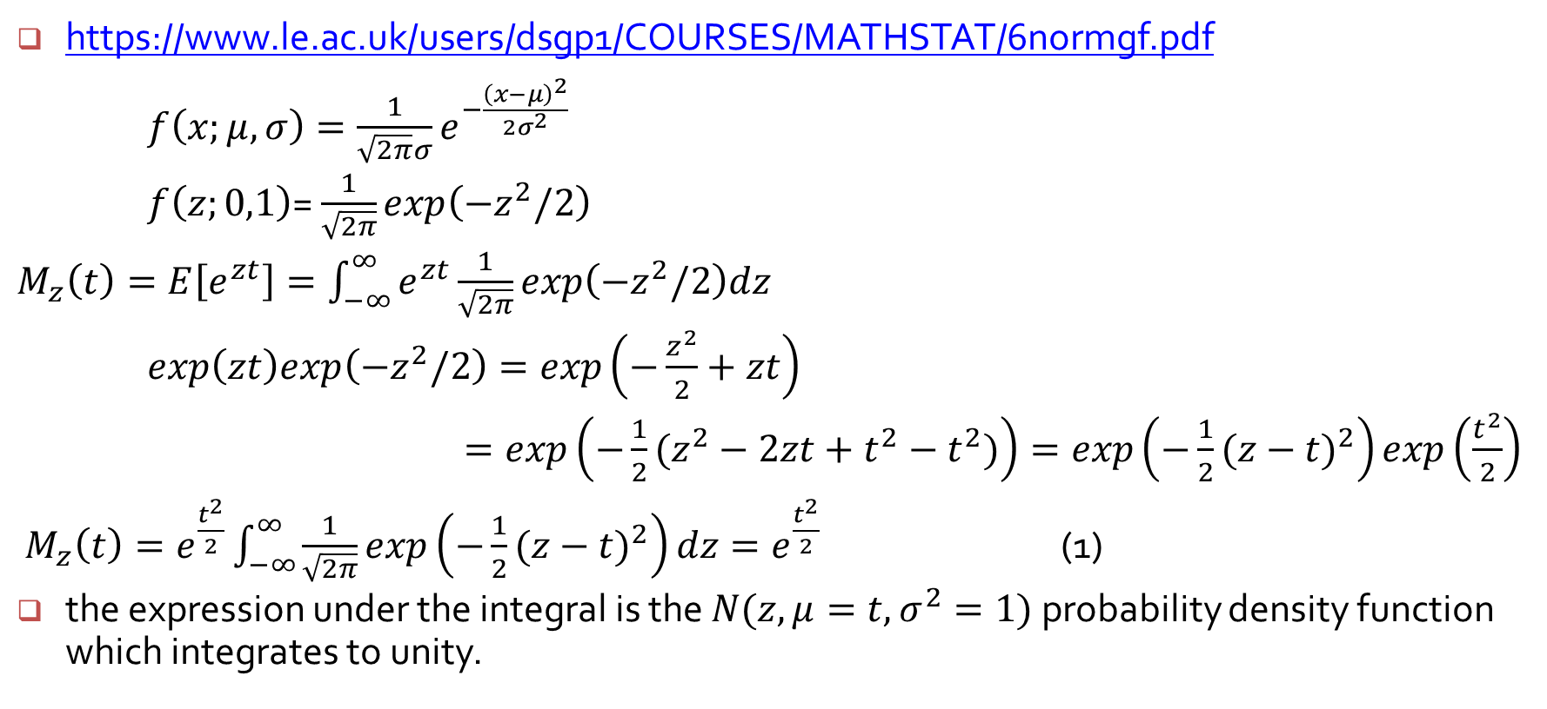
The Moment Generating Function of the Normal Distribution**
https://www.le.ac.uk/users/dsgp1/COURSES/MATHSTAT/6normgf.pdf
$f\left(x;μ,σ\right)=\frac{1}{\sqrt{2π}σ}e^{−\frac{{\left(x−μ\right)}^{2}}{2σ^{2}}}$
$f\left(z;0,1\right)$= $\frac{1}{\sqrt{2π}}exp\left(−z^{2}/2\right)$
$M_{z}\left(t\right)=E\left[e^{zt}\right]=\int_{−∞}^{∞}{e^{zt}\frac{1}{\sqrt{2π}}}exp\left(−z^{2}/2\right)dz$
$exp\left(zt\right)exp\left(−z^{2}/2\right)=exp\left(−\frac{z^{2}}{2}+zt\right)$
$=exp\left(−\frac{1}{2}(z^{2}−2zt+t^{2}−t^{2})\right)=exp\left(−\frac{1}{2}{(z−t)}^{2}\right)exp\left(\frac{t^{2}}{2}\right)$
$M_{z}\left(t\right)=e^{\frac{t^{2}}{2}}\int_{−∞}^{∞}{\frac{1}{\sqrt{2π}}}exp\left(−\frac{1}{2}{(z−t)}^{2}\right)dz=e^{\frac{t^{2}}{2}}$ (1)
the expression under the integral is the $N(z, μ=t, σ^{2}=1)$ probability density function which integrates to unity.

Slide 2
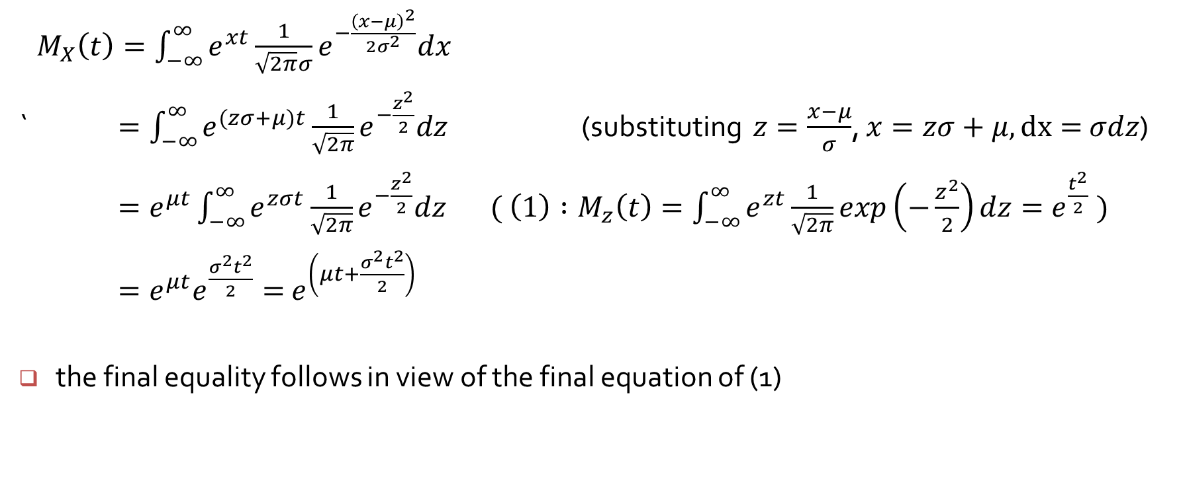
The Moment Generating Function of the Normal Distribution**
$M_{X}\left(t\right)=\int_{−∞}^{∞}{e^{xt}}\frac{1}{\sqrt{2π}σ}e^{−\frac{{\left(x−μ\right)}^{2}}{2σ^{2}}}dx$
` $=\int_{−∞}^{∞}{e^{(zσ+μ)t}}\frac{1}{\sqrt{2π}}e^{−\frac{z^{2}}{2}}dz$ (substituting $z=\frac{x−μ}{σ}$, $x=zσ+μ, dx=$ $σdz$)
$=e^{μt}\int_{−∞}^{∞}{e^{zσt}\frac{1}{\sqrt{2π}}e^{−\frac{z^{2}}{2}}dz }$ $( \left(1\right) :M_{z}\left(t\right)=\int_{−∞}^{∞}{e^{zt}\frac{1}{\sqrt{2π}}}exp\left(−\frac{z^{2}}{2}\right)dz=e^{\frac{t^{2}}{2}} )$
$=e^{μt}e^{\frac{σ^{2}t^{2}}{2}}=$ $e^{\left(μt+\frac{σ^{2}t^{2}}{2}\right)}$
the final equality follows in view of the final equation of (1)

Slide 3
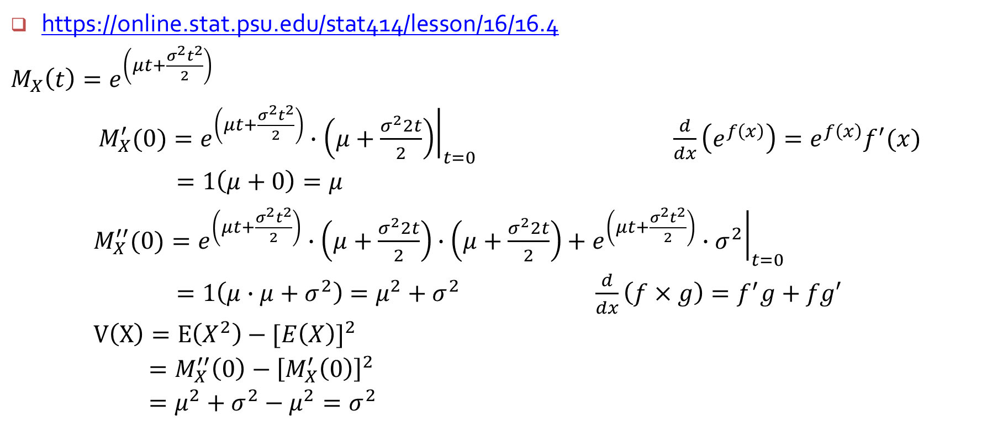
Mean and variance of the normal distribution**
https://online.stat.psu.edu/stat414/lesson/16/16.4
$M_{X}\left(t\right)=e^{\left(μt+\frac{σ^{2}t^{2}}{2}\right)}$
$M_{X}^{′}(0)={\left.e^{\left(μt+\frac{σ^{2}t^{2}}{2}\right)}∙\left(μ+\frac{σ^{2}2t}{2}\right)\right|}_{t=0}$ $\frac{d}{dx}\left(e^{f\left(x\right)}\right)=e^{f\left(x\right)}f^{′}(x)$
$=1\left(μ+0\right)=μ$
$M_{X}^{′′}(0)={\left.e^{\left(μt+\frac{σ^{2}t^{2}}{2}\right)}∙\left(μ+\frac{σ^{2}2t}{2}\right)∙\left(μ+\frac{σ^{2}2t}{2}\right)+e^{\left(μt+\frac{σ^{2}t^{2}}{2}\right)}∙σ^{2}\right|}_{t=0}$
$=1\left(μ∙μ+σ^{2}\right)=μ^{2}+σ^{2}$ $\frac{d}{dx}\left(f×g\right)=f^{′}g+fg′$
$V\left(X\right)=E\left(X^{2}\right)−{[E\left(X\right)]}^{2}$
$=M_{X}^{′′}\left(0\right)−{\left[M_{X}^{′}\left(0\right)\right]}^{2}$
$=μ^{2}+σ^{2}−μ^{2}=σ^{2}$

Slide 4
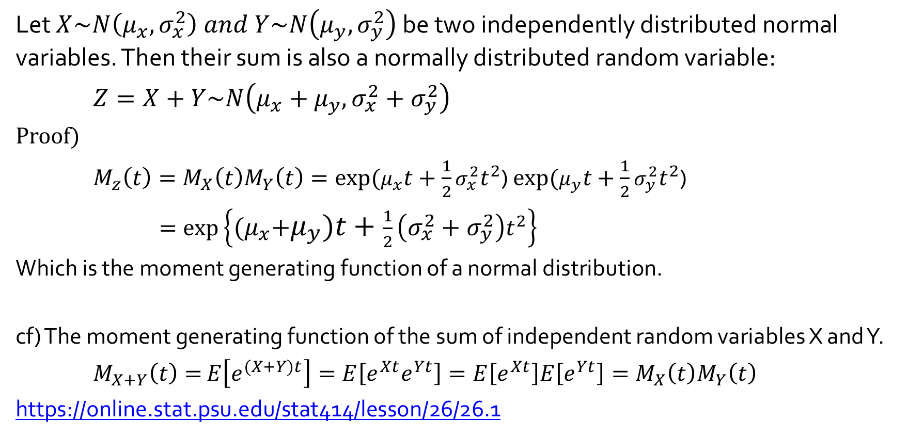
The Moment Generating Function of the Sum of Normal Distributions**
Let $X\sim N\left(μ_{x}, σ_{x}^{2}\right) and Y\sim N\left(μ_{y}, σ_{y}^{2}\right)$ be two independently distributed normal variables. Then their sum is also a normally distributed random variable:
$Z=X+Y\sim N\left(μ_{x}+μ_{y}, σ_{x}^{2}+σ_{y}^{2}\right)$
Proof)
$M_{z}\left(t\right)=M_{X}\left(t\right)M_{Y}\left(t\right)=exp⁡(μ_{x}t+\frac{1}{2}σ_{x}^{2}t^{2}$) $exp⁡(μ_{y}t+\frac{1}{2}σ_{y}^{2}t^{2}$)
$=exp⁡\left\{{(μ}_{x}+μ_{y})t+\frac{1}{2}\left(σ_{x}^{2}+σ_{y}^{2}\right)t^{2}\right\}$
Which is the moment generating function of a normal distribution.
cf) The moment generating function of the sum of independent random variables X and Y.
$M_{X+Y}\left(t\right)=$ $E\left[e^{(X+Y)t}\right]=E\left[e^{Xt}e^{Yt}\right]=E\left[e^{Xt}\right]E\left[e^{Yt}\right]=M_{X}\left(t\right)M_{Y}\left(t\right)$
https://online.stat.psu.edu/stat414/lesson/26/26.1

